Slide 1
COVID-19:
Vaccination disparity & Herd immunity
Team 24: Subin, Chen, Beth, Lee Anne

Slide 2
Introduction
COVID-19 vaccination policy in Minnesota
Herd Immunity
Minnesota’s indigenous population: challenges and disparities
Data analysis, results, discussion

Slide 3
COVID-19 vaccine policy in MN
Phase 1a: Paid and unpaid healthcare personnel, long term care residents
Phase 1b:
-Populations at high risk for severe disease
-Essential workers
Phase 1c: Energy, finance, shelter/housing/construction, IT/communications, legal, media, public safety, transportation & logistics, water and wastewater
Phase 2: General public
The MN Vaccine Allocation Advisory Group is guided by the following four principles:
Maximize benefits and minimize harms - protect the population’s health by reducing mortality and serious morbidity
Promote justice - respect people and groups, promote solidarity and mutual responsibility
Mitigate health inequities - strive for fairness and protect against systematic unfairness and inequity
Promote transparency - respond to needs respectfully, fairly, effectively, and efficiently in ways that are accountable, transparent, and worthy of trust.
Notes:
The priority groups that will be getting the vaccine first was determined by the CDC Advisory Committee on Immunization Practices (ACIP). The MN COVID-19 Vaccine Allocation Advisory Group reviews the ACIP guidelines and makes detailed recommendations for how to apply the guidelines in MN. The goal for the first, limited doses of the vaccine is to ‘immunize for impact’; that is, they are offering the vaccine to those at highest risk of getting COVID-19 and those who are at the most risk of severe disease and complications if they do get the virus. It is hard to estimate when phases will end/begin, as everything depends on vaccine supply and how many people are getting vaccinated.

Slide 4
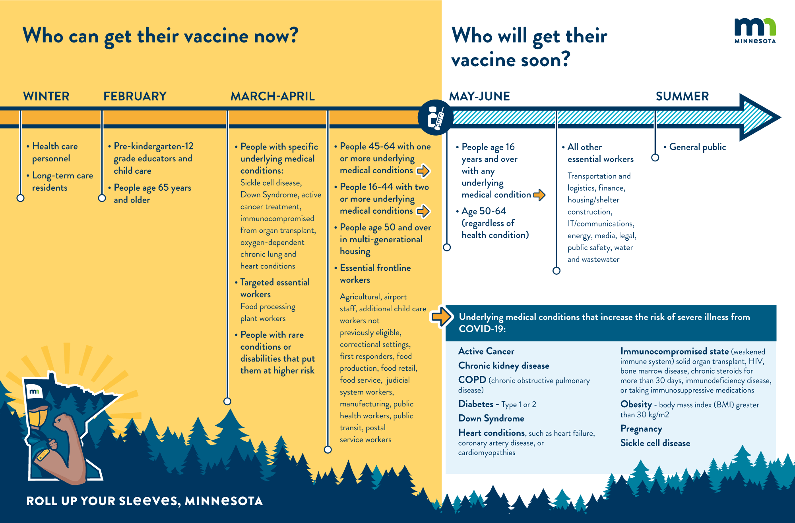
https://mn.gov/covid19/vaccine/whos-getting-vaccinated/vaccinated.jsp

Slide 5
Herd Immunity
90%?
Herd immunity makes it possible to protect the population from a disease, including those who can't be vaccinated, such as newborns or those who have compromised immune systems.
Experts estimate that herd immunity would require around 70-90% of the population to have COVID-19 immunity, either through prior infection or vaccination.
Not vaccinated
Measles: ~ 95%
Polio:~ 80%
Vaccinated
Notes:
Using the concept of herd immunity, vaccines have successfully controlled deadly contagious diseases such as smallpox, polio, diphtheria, rubella and many others.
What percentage of a community needs to be immune in order to achieve herd immunity? It varies from disease to disease. The more contagious a disease is, the greater the proportion of the population that needs to be immune to the disease to stop its spread. For example, the measles is a highly contagious illness. It's estimated that 94% of the population must be immune to interrupt the chain of transmission.
Reference:
Herd immunity and COVID-19 (coronavirus): What you need to know - Mayo Clinic
Coronavirus disease (COVID-19): Herd immunity, lockdowns and COVID-19 (who.int)
COVID-19 Vaccine Key to Reaching ‘Herd Immunity’ (muhealth.org)

Slide 6
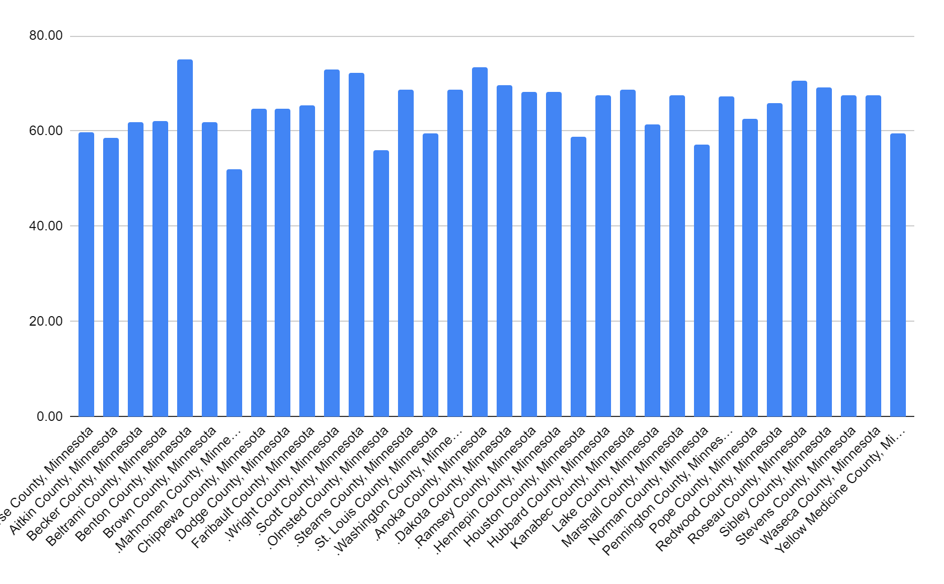
% of population required to reach herd immunity (90% vaccinated)

Slide 7
Indigenous Populations in Minnesota
Approximately 70,000 Minnesotans claim indigenous (or American Indian) heritage.
Unfortunately, indigenous Minnesotans have poorer health outcomes and higher mortality rates than any other demographic group.
This is caused, in part, by poverty, a lack of education, and a lack of culturally sensitive healthcare providers.

Slide 8
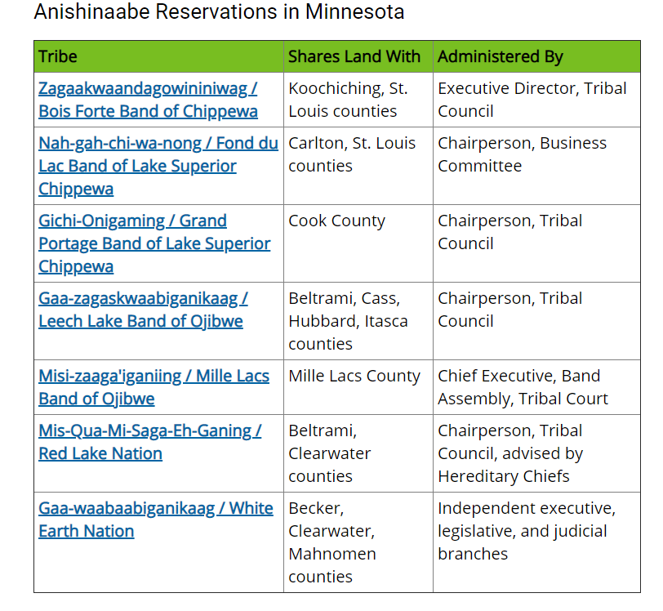
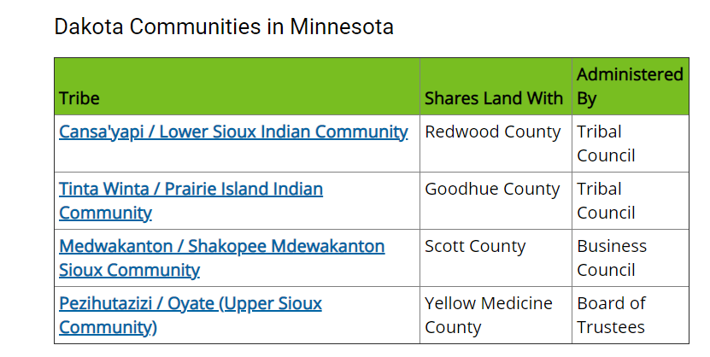
Minnesota Reservations
Notes:
Much of Minnesota’s indigenous population lives either in Minneapolis or on one of Minnesota’s eleven reservations. Members of indigenous tribes who do not live on a reservation may go back lto visit or celebrate cultural events. oOne benefit to living on a reservation could be access to nearby, culturally sensitive healthcare providers. ives either in Minneapolis or on one of Minnesota’s eleven reservations.

Slide 9
Caring for Our Indigenous Population
It is unlikely that the allocation of additional funding alone with heal the disparities
When providing care to our indigenous population, we must consider the following factors:
-frequent migration between the Twin Cities and rural reservations
-many indigenous individuals prefer traditional spiritual healing processes in addition to Western medicine
-a higher proportion of the indigenous population does not trust Western medicine or medical professionals and believes that medical professionals discriminate against indigenous patients
-many indigenous patients report that they do not understand which services their insurance covers
Notes:
Because of these factors, it is possible that members of indigenous groups who live on reservations have better access to healthcare than members of indigenous groups who live in large cities like Minneapolis.

Slide 10
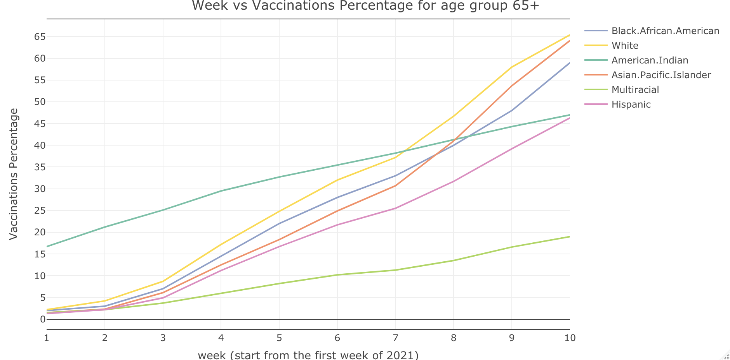
Indigenous Populations and COVID Vaccination
Notes:
We believe that the difficulty of accessing care in the city versus the relative ease of accessing care on a reservation could help explain the data showed in the graph above. It is possible that members of the indigenous community living on reservations were first vaccinated with relative ease, but after that initial spike, fewer and fewer members of the indigenous population received the vaccination. You can see that, up to week seven of ten, the indigenous population had the highest vaccination rate out of any ethnic group in Minnesota. Then, in weeks seven through ten, the rate of indigenous vaccination slows and is overtaken by the rate of vaccination for other ethnic groups. We believe that reservation v. non reservation could explain these findings, in part, because indigenous groups generally have poorer health outcomes than other groups in Minnesota and no other ethnic group has access to a reservation-like setting.

Slide 11
Data analysis
Datasets:
Variables:
COVID-19 Community Profile Report - County-Level
County Population by Characteristics: 2010-2019
Minnesota Vaccinations by Race and Ethnicity
People Vaccinated, by County
Minnesota County
Percentage of People with at least One Vaccine Dose
Percentage of People older than 65
Whether the county has a reservation
Percentage of ethnically white Americans for each county
Total COVID cases for each county
Total COVID deaths for each county

Slide 12
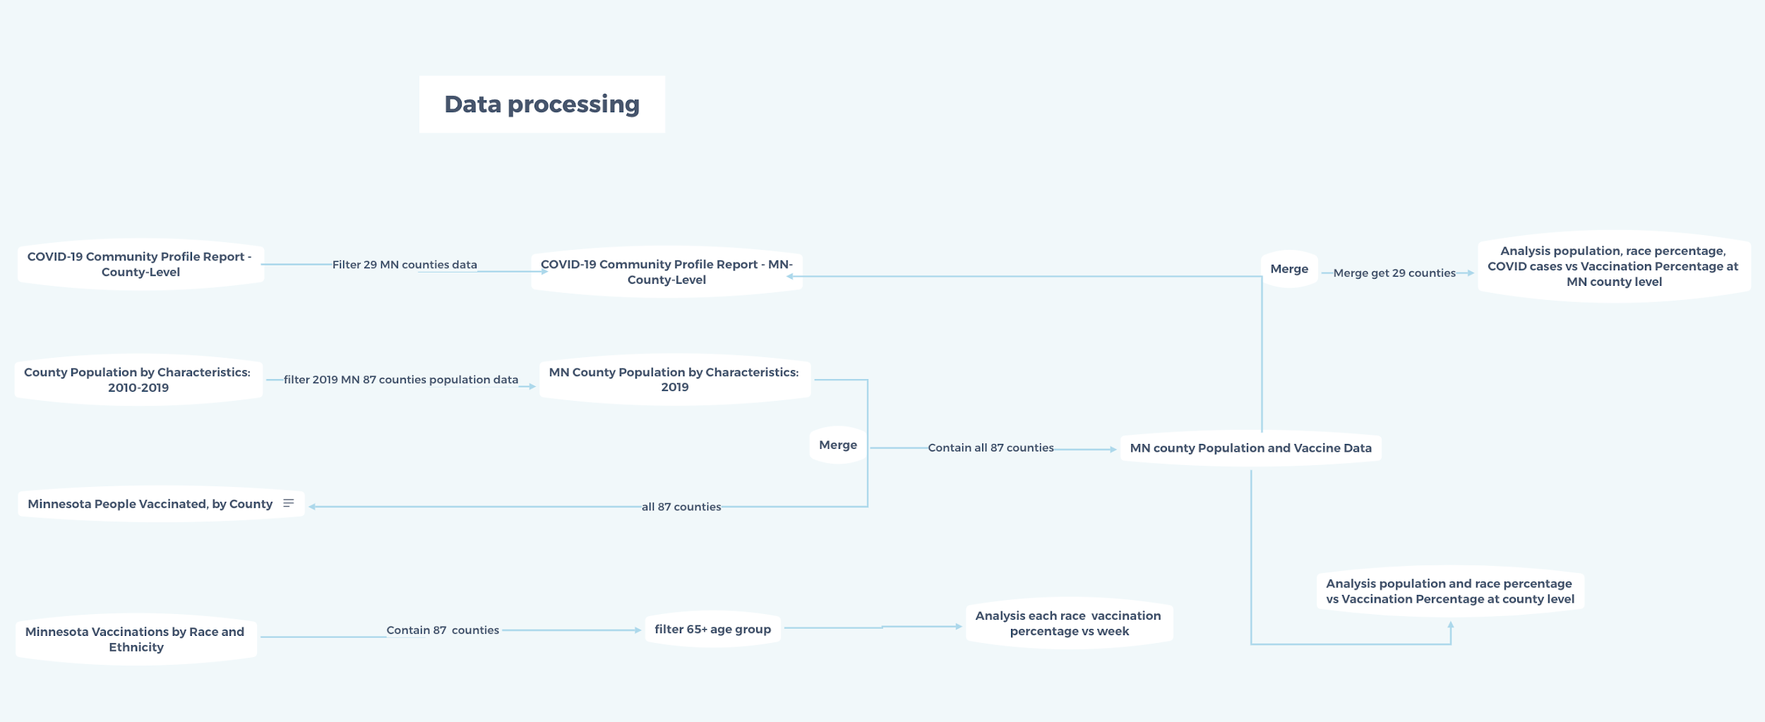

Slide 13
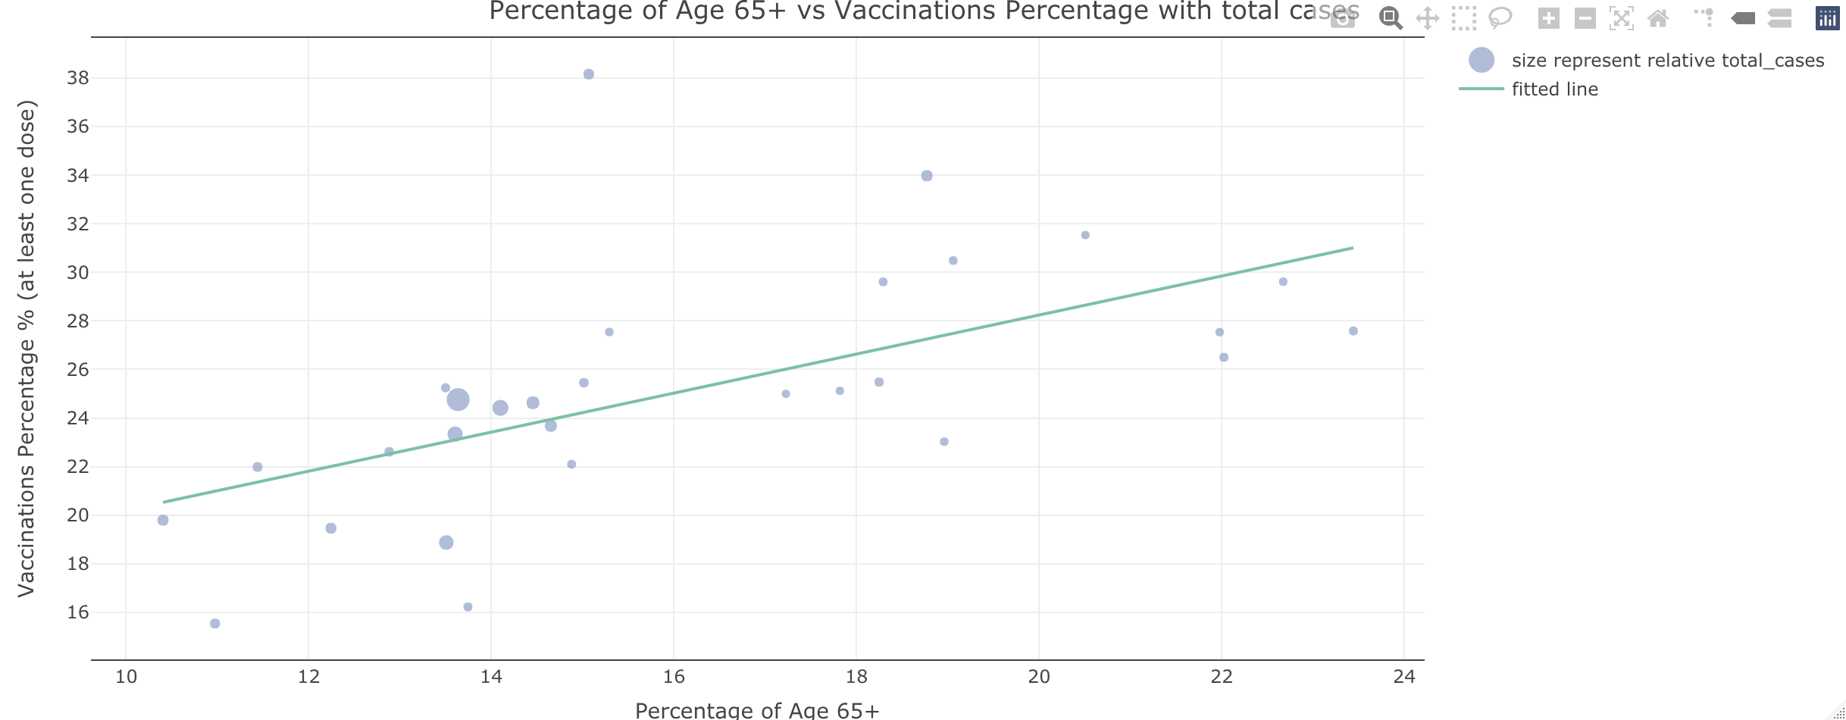
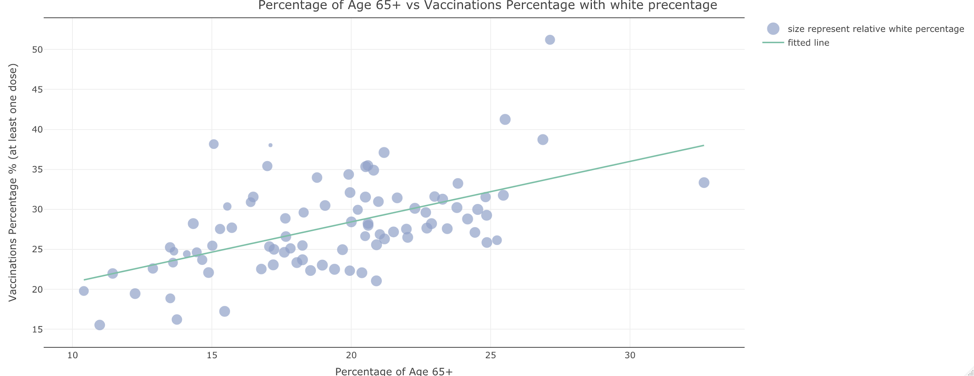
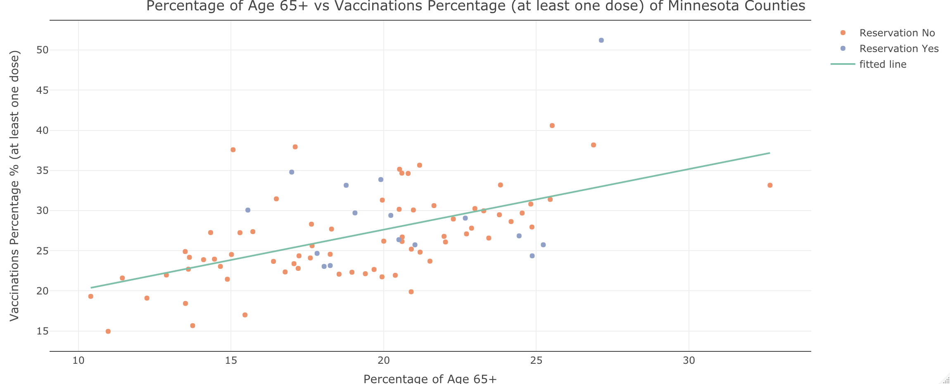
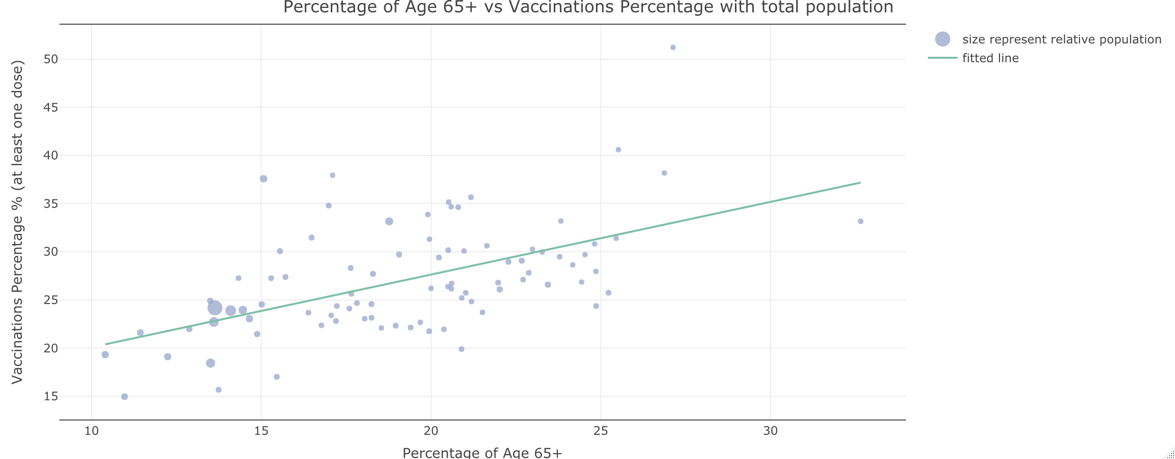
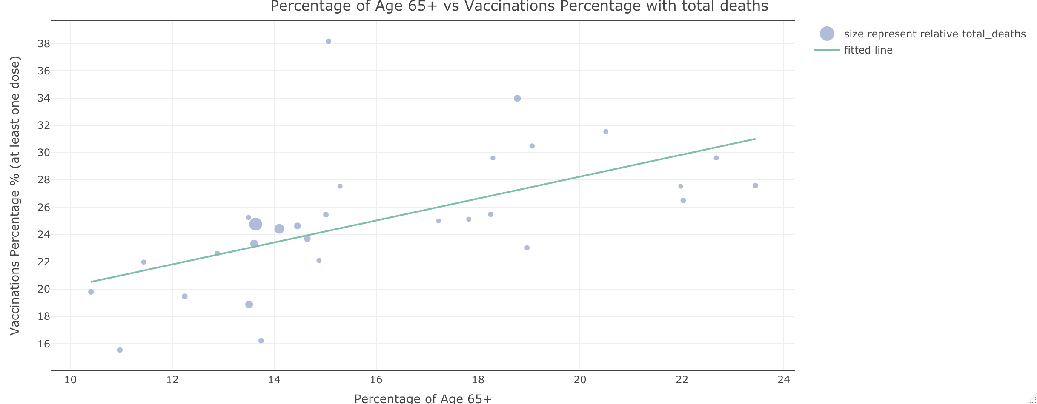
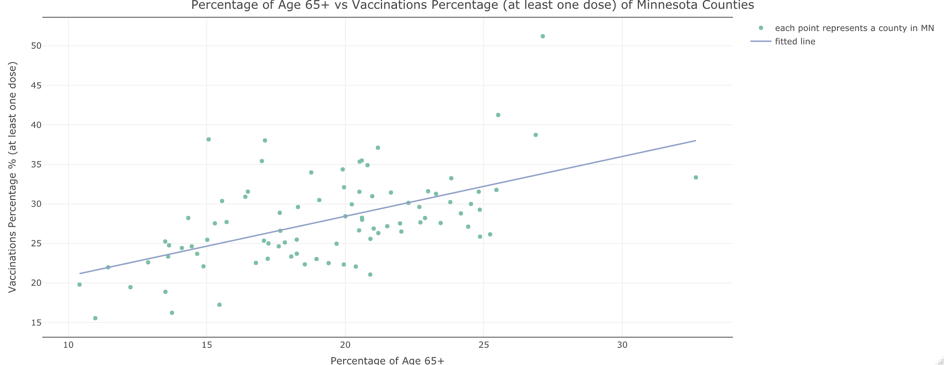
Visualization
More interactive visualization：TEAM24_app
Vaccine Distribution policy gave priority to Minnesotans aged 65 or older at first, so the percentage of people older than 65 plays an important role in percentage vaccinated for each county.
Fitted line of percentage age group 65+ on percentage of vaccine for each county

Slide 14
Model
Individual : Minnesota County
Outcome : Percentage of People with at least One Vaccine Dose
Adjustment Covariate: Percentage of People older than 65
Covariate :
Whether the county has a reservation
Percentage of ethnically white Americans for each county
Total COVID cases for each county
Total deaths for each county
Model : Regress covariate on outcome
More details: TEAM 24 github repository

Slide 15
Results
Percentage of People older than 65 with at least One Vaccine Dose is significant
White Americans have a significantly lower vaccination rate than expected
Counties with more COVID cases and deaths tend to have a higher percentage of vaccination

Slide 16
Discussion/ Further work
Herd immunity: Will everyone want to get the vaccine? Will we ever reach near 90% vaccinated?
Future policy changes - and virus mutations
How can we provide vaccines in an effective and culturally sensitive manner to members of indigenous groups living in Minneapolis?
When there are sufficient doses of the vaccine available in the future, policy will not dominate the percentage of vaccination anymore. Causal inferences about each ethnicity’s vaccination rate will be more meaningful.
If the Vaccine Distribution policy changed in the future, the model could still work, but we would need to change the adjustment covariate to other age group percentage.
If we knew the ethnicities of the individuals receiving the vaccine within each age group, we could complete further analysis.

Slide 17
Thank you!

Slide 18
References
Minnesota Department of Health Covid-19 Vaccine Phases and Planning. https://www.health.state.mn.us/diseases/coronavirus/vaccine/plan.html#:~:text=The%20goal%20for%20the%20first,if%20they%20get%20COVID%2D19
Culture Care Connection, American Indians in Minnesota. http://www.culturecareconnection.org/matters/diversity/americanindian.html
Minnesota Department of Health, The Health and Well-being of Minnesota’s Adoleescents of Color https://www.health.state.mn.us/data/mchs/surveys/mss/docs/specialreports/adolescentsofcolor.pdf
Minnesota Department of Health, Health care needs assessment: White Earth Nation members and other American Indians in the Twin Cities https://www.leg.mn.gov/docs/2012/mandated/120422.pdf
https://www.mncompass.org/profiles/county
https://www.nytimes.com/2020/12/24/health/herd-immunity-covid-coronavirus.html
https://www.mayoclinic.org/diseases-conditions/coronavirus/in-depth/herd-immunity-and-coronavirus/art-20486808
https://www.who.int/news-room/q-a-detail/herd-immunity-lockdowns-and-covid-19
https://slidesgo.com/themes

